Slide 1



WEEK 13
HIP-HOP
PRESENTED BY:
LONOZA, ALCAIDE, CABUDSAN,
DALUGDOG, NAMIAS, PALOMARES

Slide 2

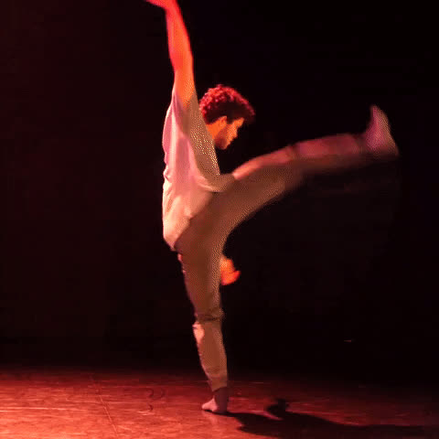

CONTEMPORARY DANCE
Contemporary dance is a style of expressive dance that combines elements of several dance genres including modern, jazz, lyrical and classical ballet. Contemporary dancers strive to connect the mind and the body through fluid dance movements.

Slide 3

INTRODUCTION
Welcome to an exploration of one of the most influential and dynamic dance styles of our time – hip-hop dance. Originating in the vibrant streets of the Bronx, New York City, during the 1970s, hip-hop dance has transformed from a local movement into a global cultural phenomenon that continues to captivate and inspire people of all ages and backgrounds.

Slide 4
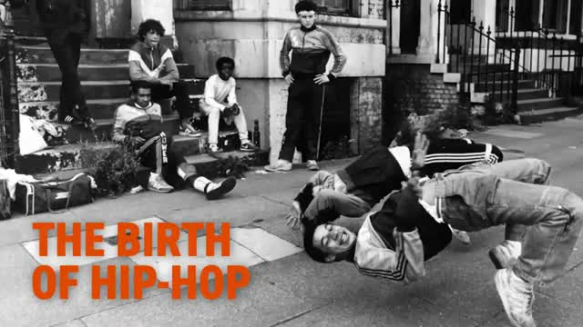

Slide 5

DEFINING HIP-HOP DANCE
01
Hip-hop dance: A vibrant and expressive street dance style originating from the Bronx, NYC, during the 1970s.
02
A unique fusion of movement, rhythm, and storytelling that has evolved into a global cultural phenomenon.

Slide 6




CHARACTERISTICS OF HIP-HOP DANCE
Complex Footwork
High Energy
Requires Attitude
Highly Versatile
Hip-hop dance place high emphasis on the footwork of the artists. They use complex foot movements while following the energetic beat of hip-hop music.
Hip hop music comes with heavy beats and is suitable for quick-paced movements. It demands high stamina and endurance otherwise the dance will not look energetic and exciting.
Hip hop dance is a highly versatile form of dance. You can perform it with many people or rule the stage alone. Because of its popularity this dance can suit any age and fitness level.
Hip hop dancers always stay in style and carry a particular attitude. They are full of confidence and boldness.

Slide 7
CHARACTERISTICS OF HIP-HOP DANCE
Isolation
Groove
Breaking
Freestyle
Precise control of body parts for sharp and distinct movements.
Syncing movements to rhythm, creating a captivating flow.
Gravity-defying floor-based moves, spins, and tricks.
Embracing improvisation and personal style.

Slide 8





MOVEMENT SKILLS IN HIP-HOP DANCE
Popping and Locking
Breaking Moves
Glide and Tutting
Dynamics
Transitions
Quick muscle contractions and releases for dynamic effects.
High-energy footwork, spins, and power moves.
Smooth gliding motions and intricate hand formations.
Playing with levels, speed, and energy for engaging performances.
Seamless movement shifts that enhance the overall routine.

Slide 9



Slide 10




FITNESS BENEFITS OF
HIP-HOP DANCE
Cardiovascular Health
Energetic routines elevate heart rate and endurance.
Muscle Strength
Engaging diverse muscle groups for strength and toning.
Flexibility
Incorporating stretches and dynamic movements.

Slide 11


FITNESS BENEFITS OF HIP-HOP DANCE
Coordination and Balance
Complex choreography enhances control and balance.
Mental Well-being
Expressive outlet reduces stress and uplifts mood.

Slide 12


DIETARY GOALS FOR HIP-HOP DANCE
A dietary goal of a Hip-hop dancer consists mostly of carbohydrates. Approximately 55% to 60% of a dancer's diet should be carbs. Because of the fast-paced and energetic dance style of hip-hop, Dancers need to ingest carbs to supply for their energy. Around 12-15% should come from protein; and less than 20-35% from fat.
For the people that are trying to use hip-hop dancing as an exercise to maintain their ideal body weight. Their dietary goal should be is to eat plenty of vegetables and fruits. Ensure moderate use of edible oils. Avoid overeating to prevent overweight and obesity.

Slide 13
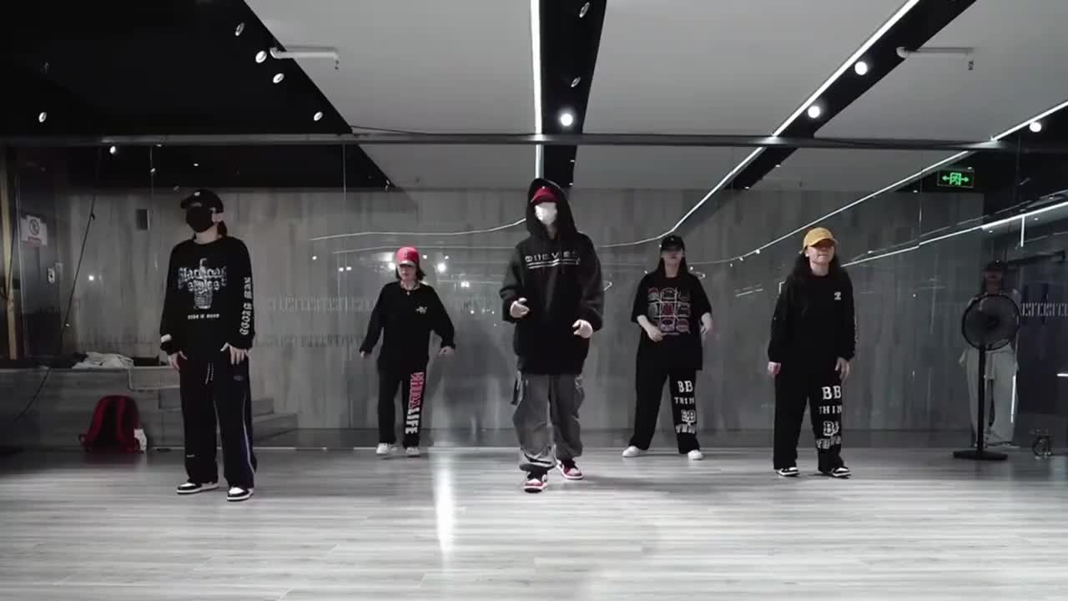
HIP HOP

Slide 14

CONCLUSION
IN CONCLUSION, OUR EXPLORATION OF HIP-HOP DANCE REVEALS:
EXPRESSION: HIP-HOP IS A DYNAMIC LANGUAGE OF MOVEMENT, CONVEYING STORIES AND EMOTIONS.
UNITY: IT BRIDGES CULTURES AND CONTINENTS, UNITING PEOPLE THROUGH RHYTHM AND STYLE.
WELLNESS: BEYOND DANCE, IT FOSTERS PHYSICAL FITNESS, MENTAL WELL-BEING, AND HEALTHY LIFESTYLES.
INFLUENCE: HIP-HOP'S IMPACT EXTENDS BEYOND DANCE FLOORS, SHAPING CULTURE, MUSIC, AND FASHION.

